Slide 1
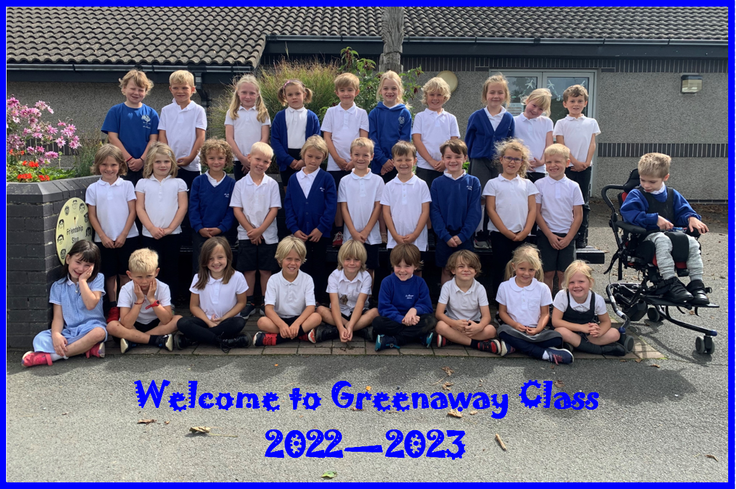

Slide 2
A warm welcome to Greenaway Class
Purpose of the meeting:
To let you know a little bit more about Greenaway Class and Year 2.
To discuss reading, writing and maths and what this looks like. To share ideas of how you can support your child at home.
To briefly talk about the end of Key Stage 1 Assessments.
Share our class website page.
Provide an opportunity for you to ask any questions you may have.
A chance for you to have a look around our classroom.

Slide 3
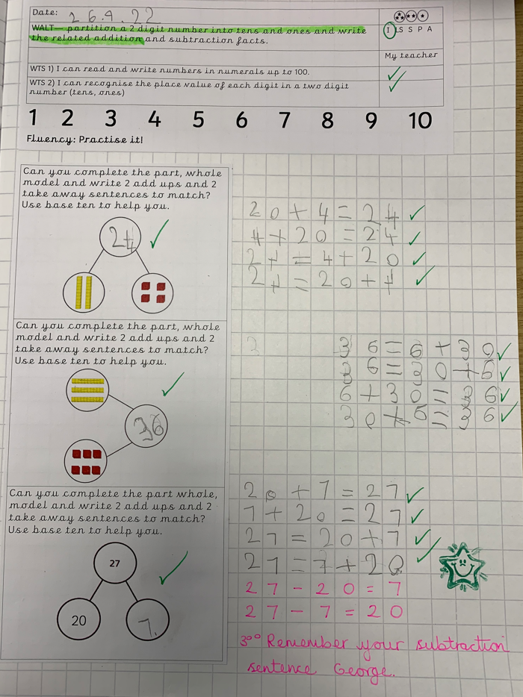
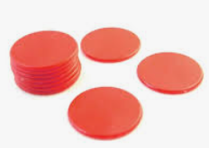
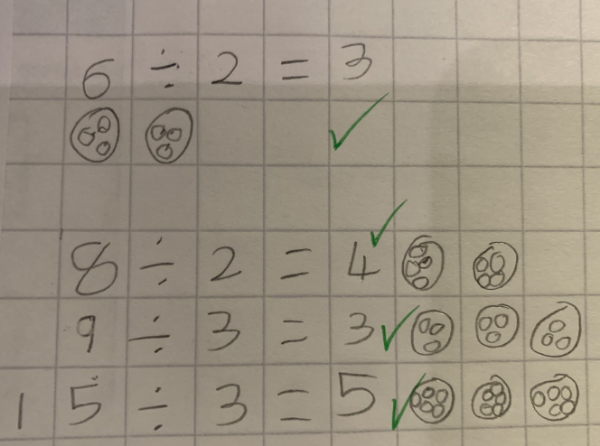
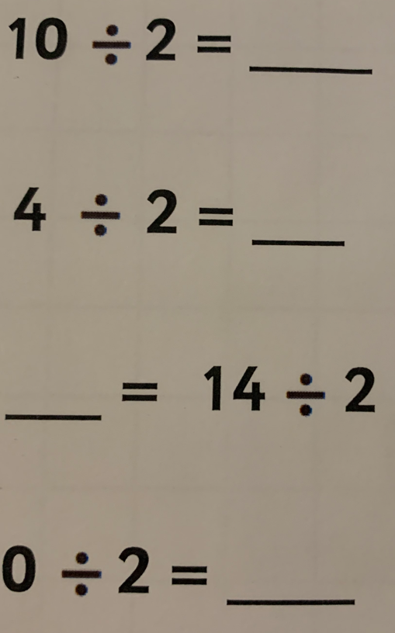
What does maths look like in Year 2?
3 key areas in maths:
Fluency – recall
Reasoning – developing their mathematical vocabulary and ability to explain their thinking.
TRUE or FALSE, Mark my work, What’s the same? What’s different? Which is the odd one out?
Problem Solving – exploring more open-ended questions and linking problems to everyday life. Problems may include more than one step.
Concrete Pictorial Abstract
1. Make it!
2. Draw it!
3. Write it!
4. Say it!

Slide 4
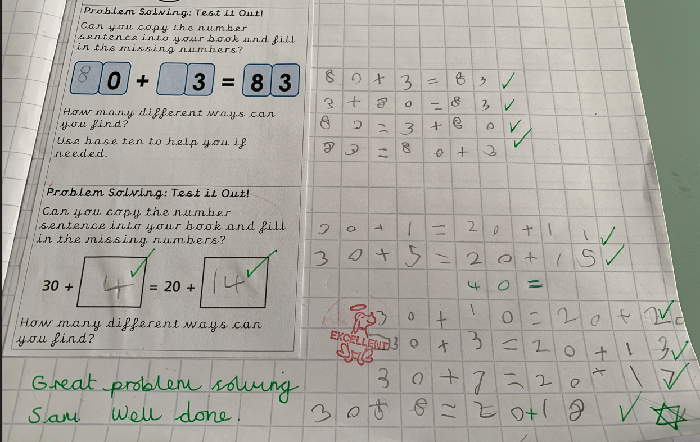
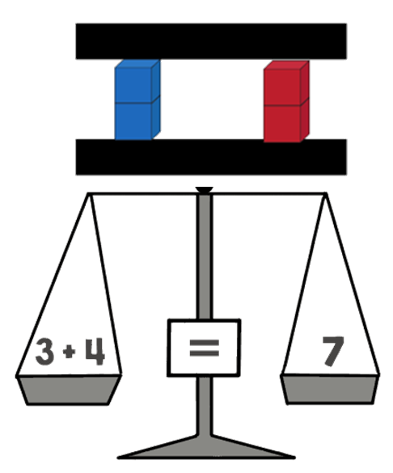
What does maths look like in Year 2?

Slide 5
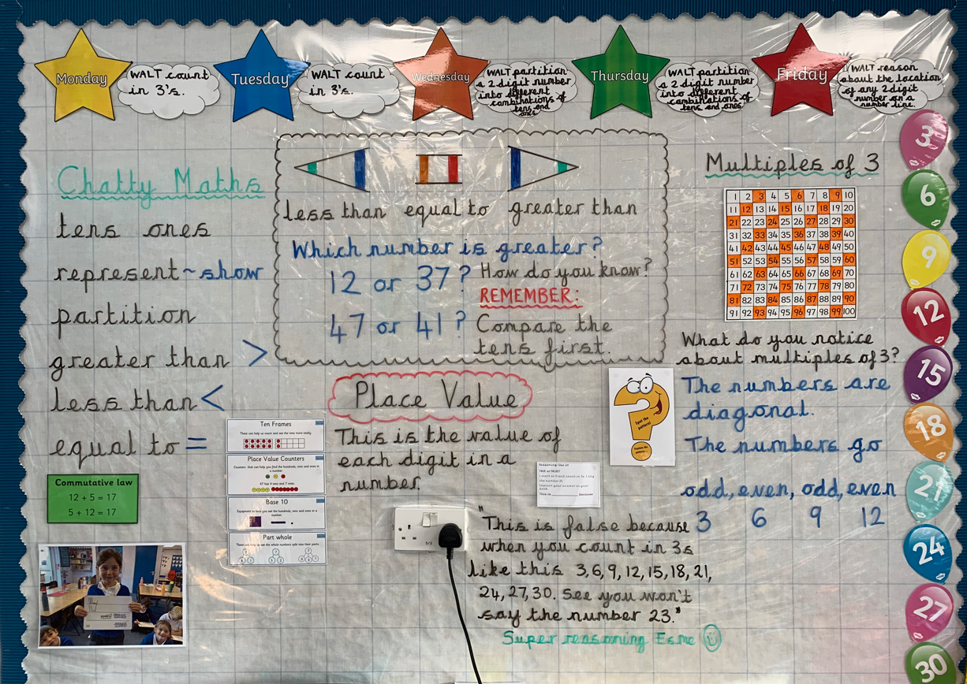
What does maths look like in Year 2?

Slide 6
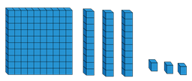
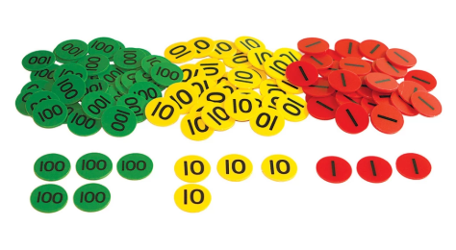
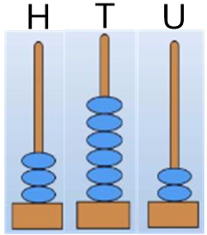
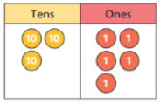
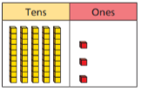
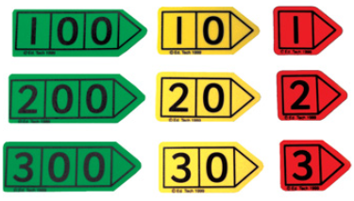
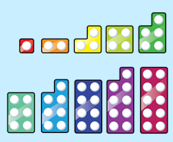
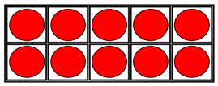
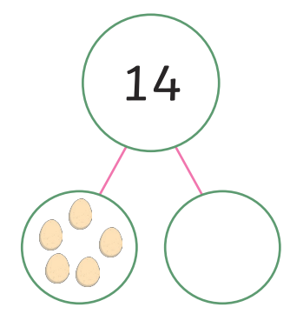
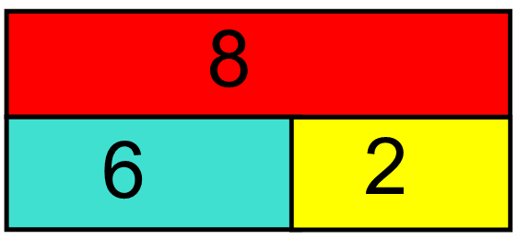
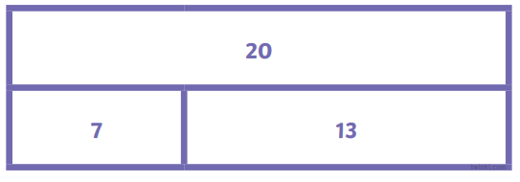
Conceptual Variation

Slide 7
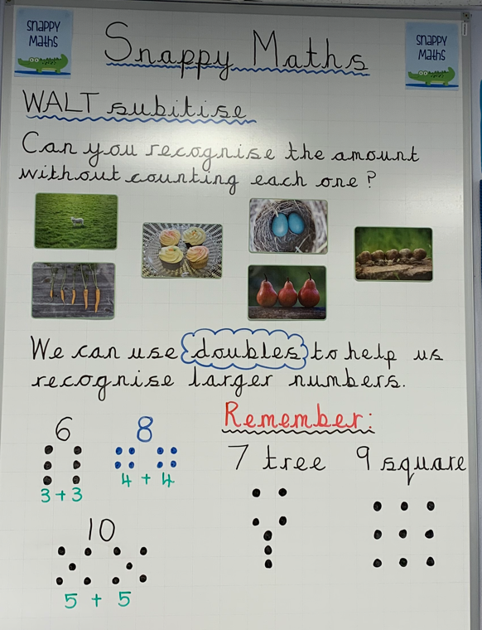
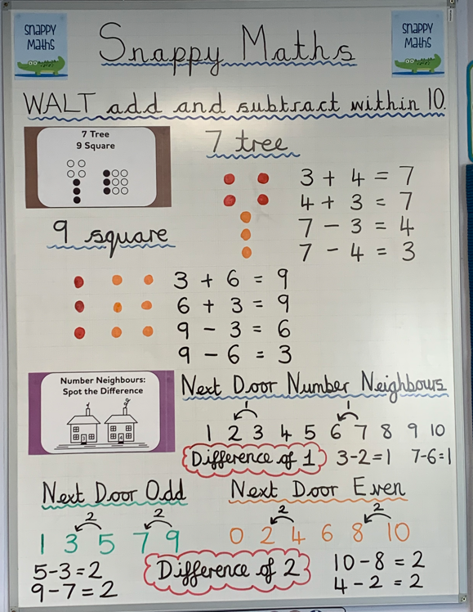
What does maths look like in Year 2?
Snappy Maths (Number Sense Maths)

Slide 8
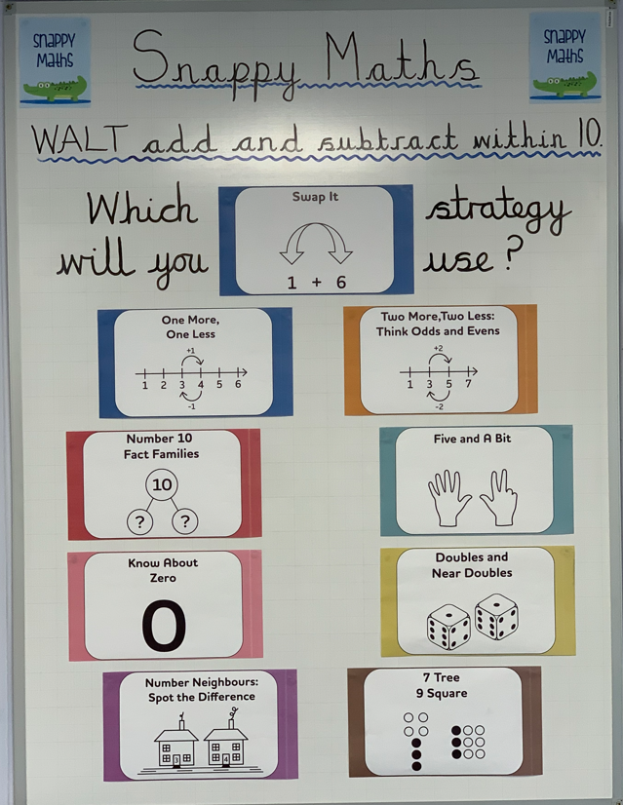
What does maths look like in Year 2?
Snappy Maths (Number Sense Maths)

Slide 9
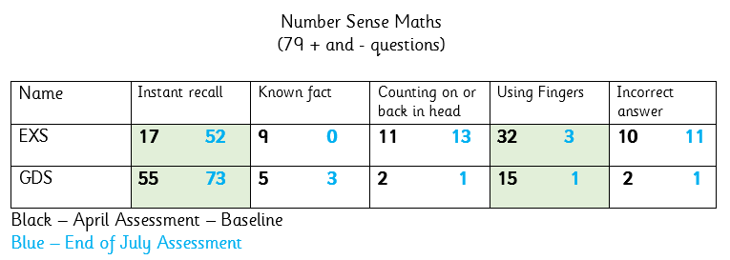
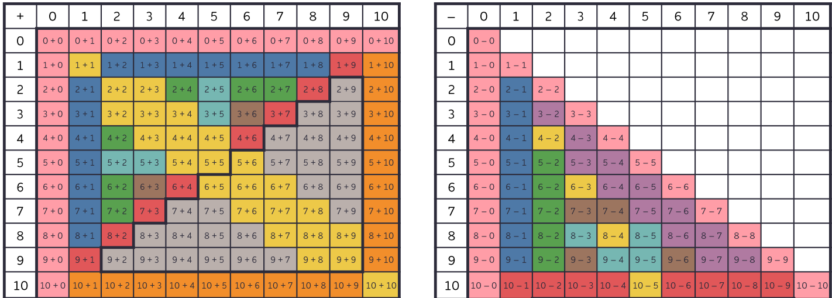
What does maths look like in Year 2?
Snappy Maths (Number Sense Maths)

Slide 10
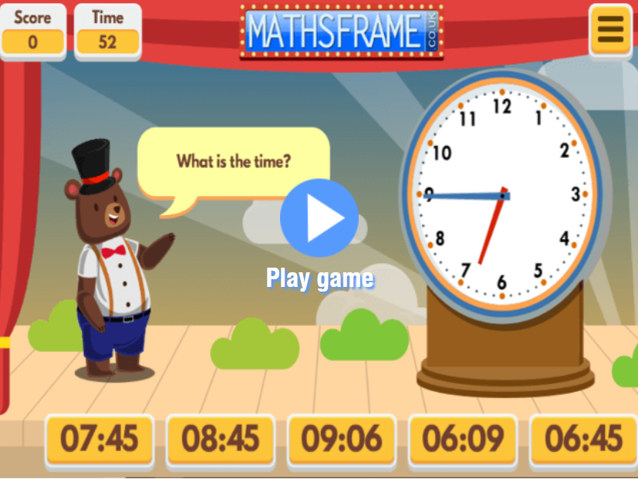
What does maths look like in Year 2?
Free Online Maths Games
Recall Number Bonds to 10 and 100 Telling the time to nearest 15 minutes
Recall Number Bonds to 20. Telling the time to the nearest 5 minutes
Doubles and Halves
Times table facts - 2x, 5x, 10x and 3x

Slide 11
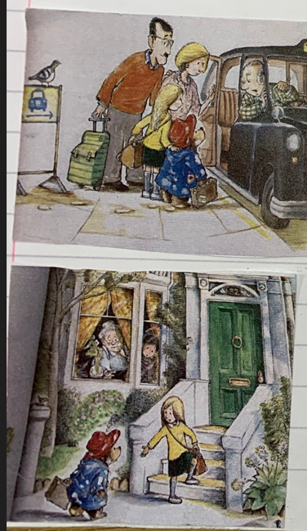
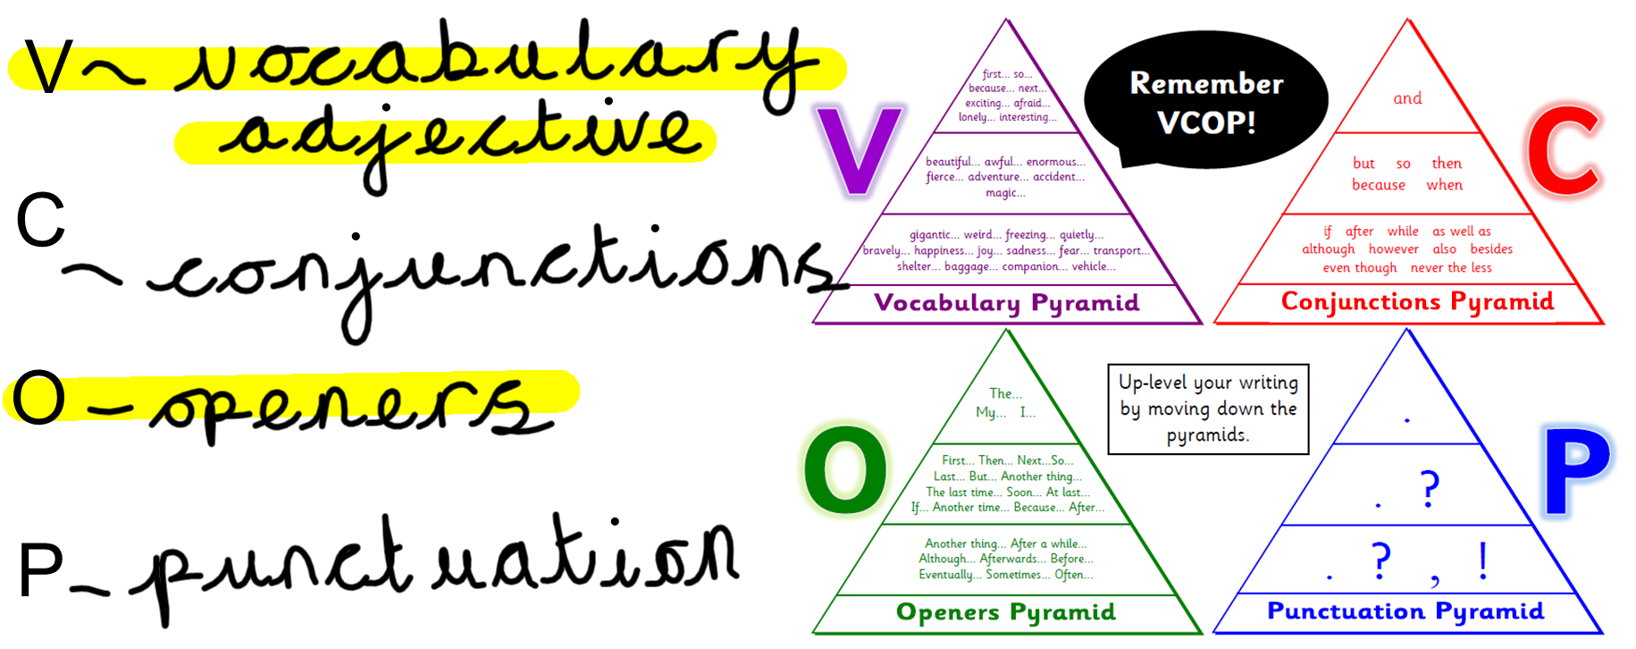
What does writing look like in Year 2?

Slide 12
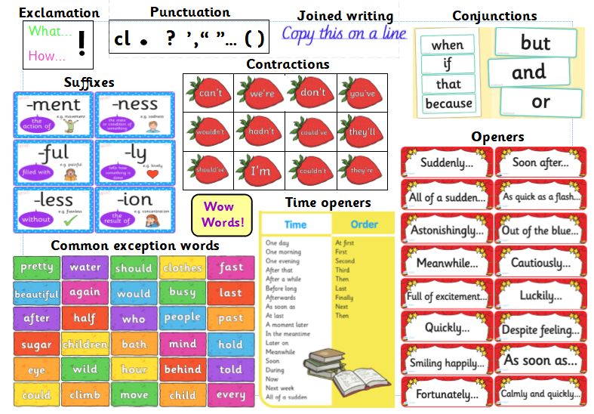
What does writing look like in Year 2?

Slide 13
What does writing look like in Year 2?
V C O P and Pink Wishes

Slide 14
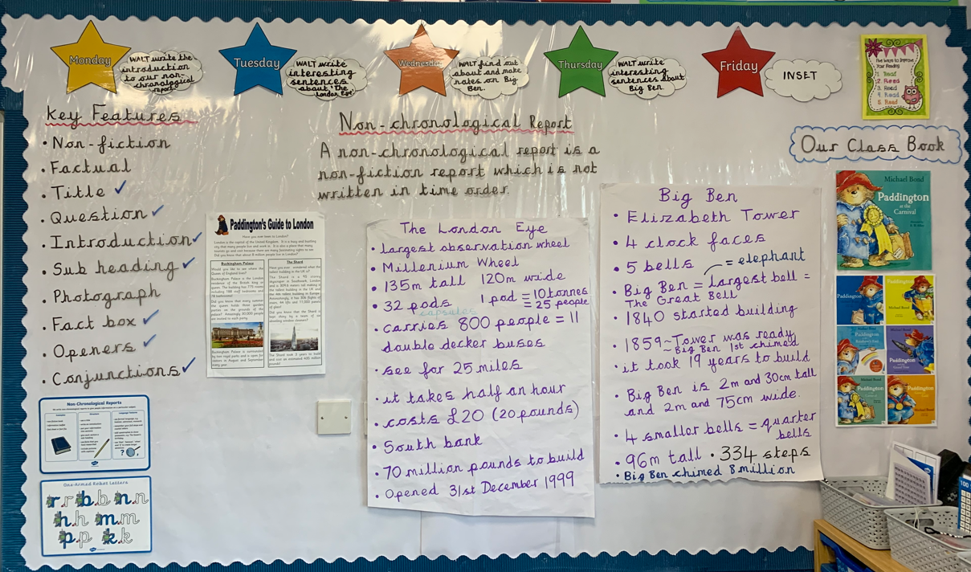
What does writing look like in Year 2?

Slide 15
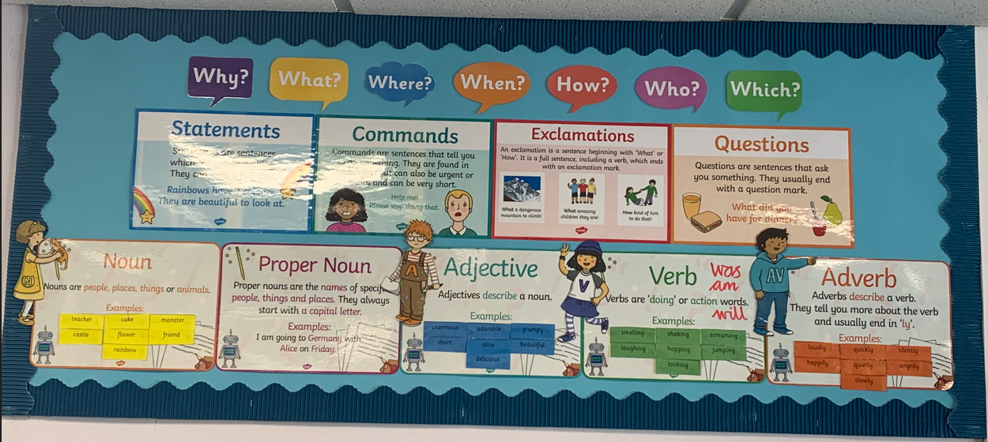
What does writing look like in Year 2?

Slide 16
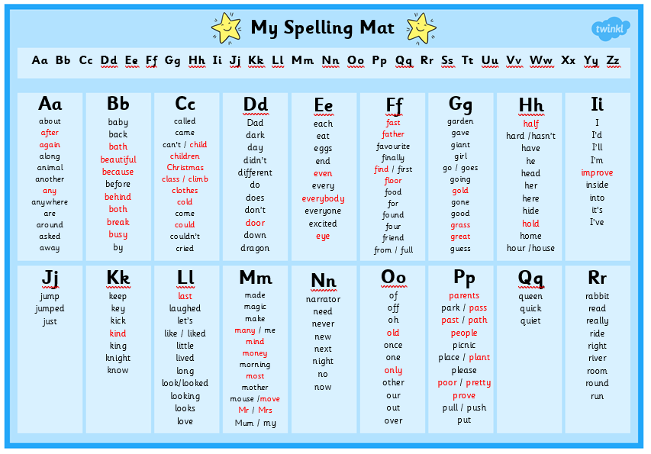
What does writing look like in Year 2?

Slide 17
What does writing look like in Year 2?

Slide 18
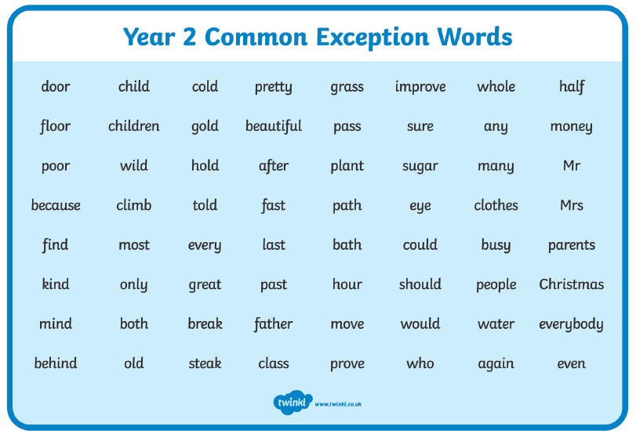
What does writing look like in Year 2?

Slide 19
What does writing look like in Year 2?

Slide 20
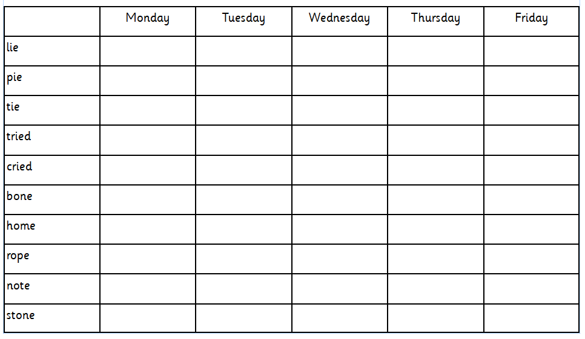
Weekly Spellings

Slide 21
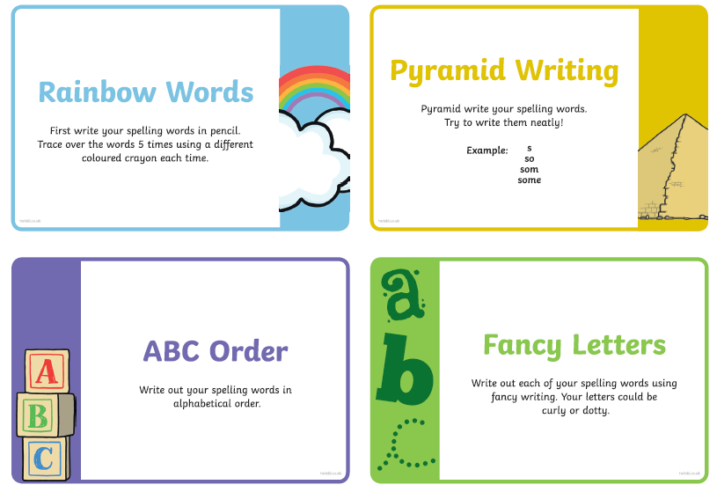
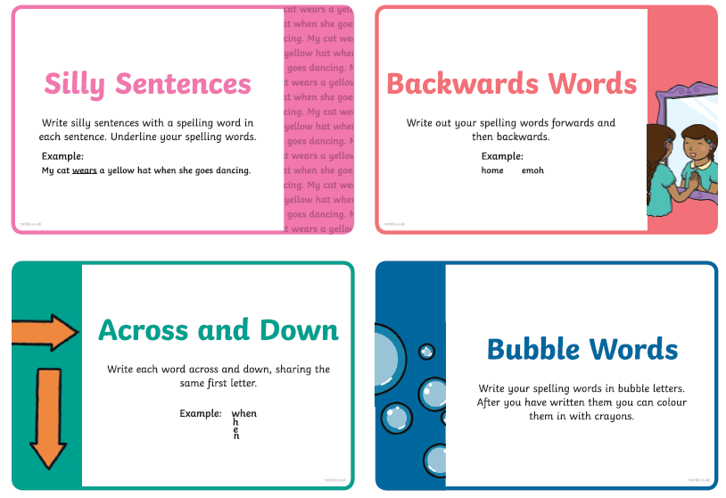
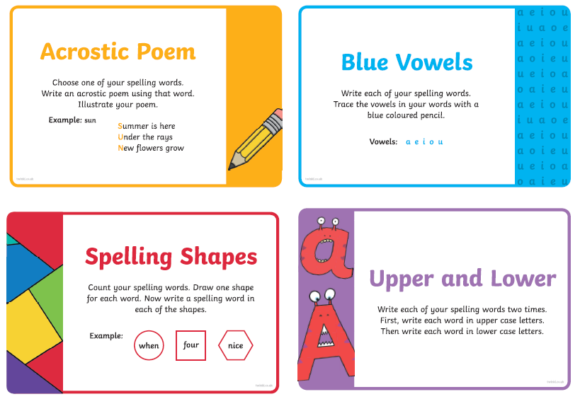
Spelling Strategies

Slide 22
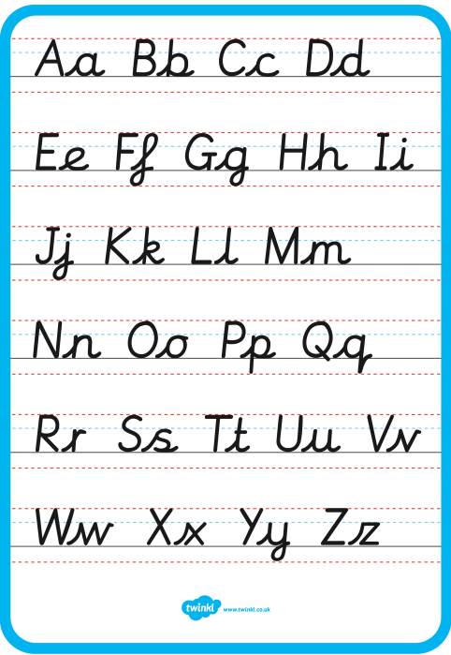
Handwriting
In Year 2 we learn to join our writing.
First, we learn to use lead ins which makes it much easier when we come to join our letters together.

Slide 23
What does reading look like in Year 2?
Daily phonic sessions
Group Reading 3x per week just like in Year 1.
Reading Comprehension – VIPERS
Reading for enjoyment. Reading is a ‘HOOT’ in Year 2!
Our Reading Tree Reward – Read, Read, Read!
Certificates

Slide 24
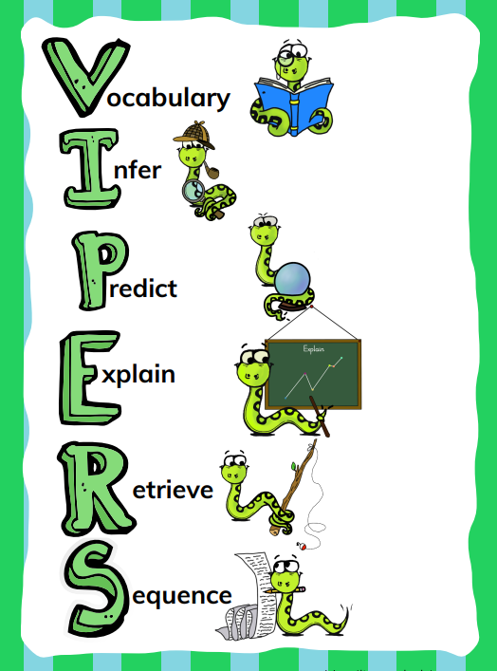
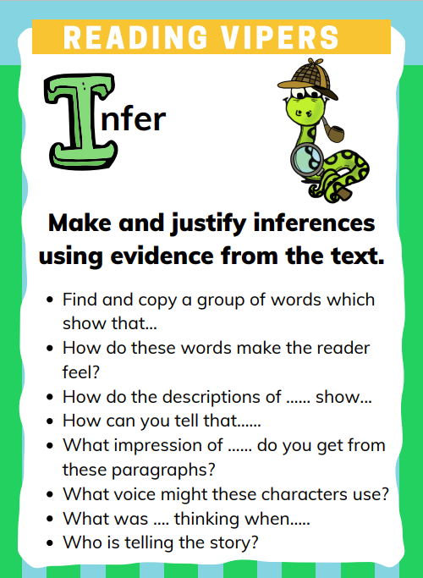
What does reading look like in Year 2?

Slide 25
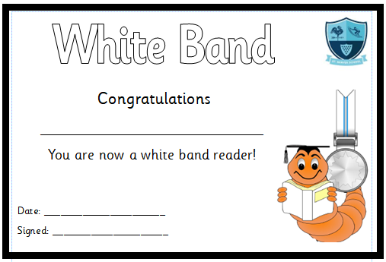
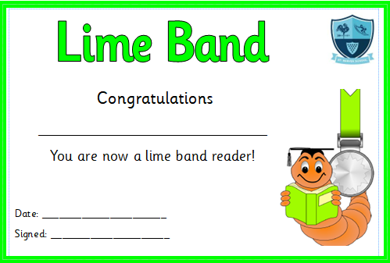
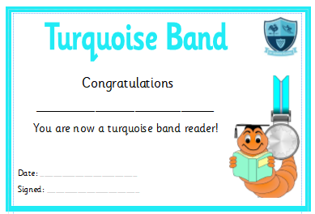
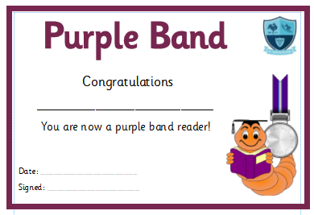
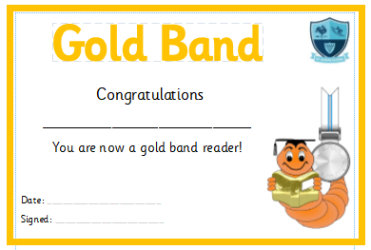
Reading Certificates

Slide 26
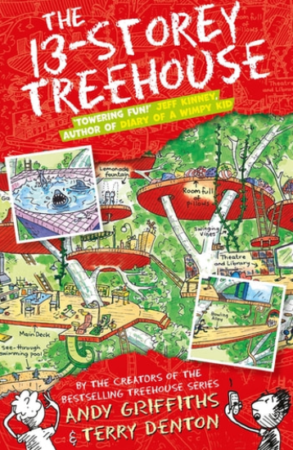
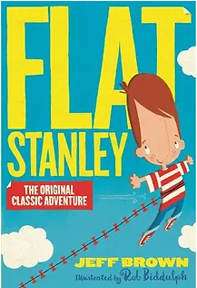
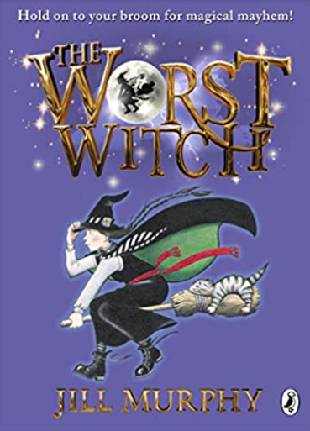
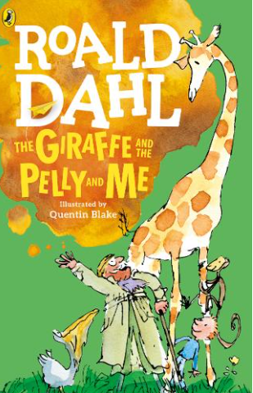
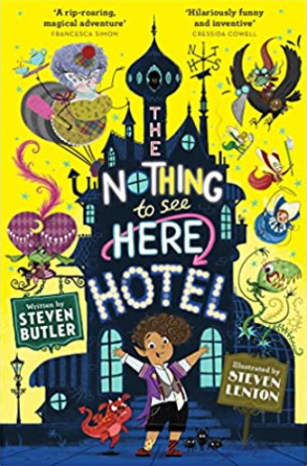
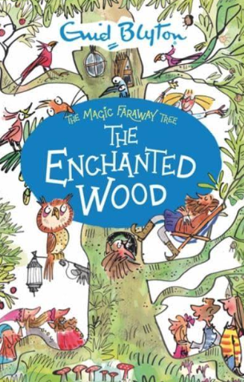
Mrs Cudmore’s Top Reads
Reading for pleasure
Sharing and discussing books read with their friends
Creating a buzz in the classroom around books.
“Can I read that book next?”
“Do you have any more books by Steven Butler?”
“ This book is so funny. I loved it!”

Slide 27
Our Reading Tree

Slide 28
End of Key Stage One Assessment
Year 2 SATs will take place in May.
The children will sit the following papers:
1 x Arithmetic Paper
1 x Reasoning Paper
1 x SPAG (Spelling, Punctuation and Grammar) Paper
2 x Reading Papers
Please remember that these papers are a small part of my overall teacher assessment.
Throughout the year I will be gathering evidence towards a set of standards the children need to meet in order to be working at the expected standard for their year group.

Slide 29
End of Key Stage One Assessment
WTS – working towards the standard of Year 2.
EXS – working at the standard of Year 2
GDS – working at greater depth within the standard of Year 2.

Slide 30
End of Key Stage One Assessment
WTS – working towards the standard of Year 2.
EXS – working at the standard of Year 2
GDS – working at greater depth within the standard of Year 2.

Slide 31
School Website (www.stminver.org)
Greenaway Class Page

Slide 32
Finally…
Thank you very much for your time!
We are so proud of all the children in Greenaway for the way that they have settled into their new routines. We hope they are enjoying school just as much as we are.
Do you have any questions?

